Slide 1
Binary Search Trees

Slide 2
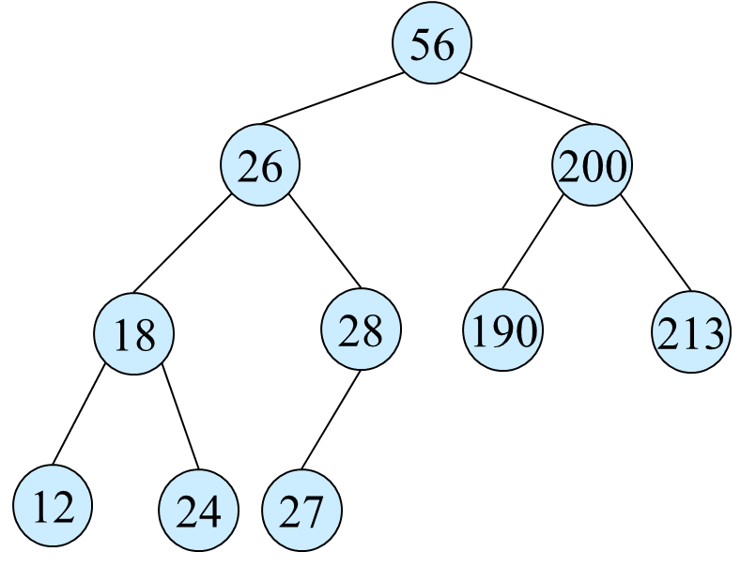
BST Representation
Node Based
data
Leftchild
Rightchild
Parent pointer (optional)
data
leftchild
rightchild

Slide 3
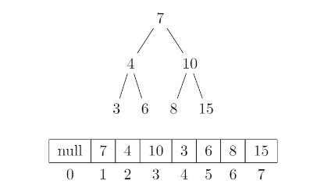
BST Representation (cont)
Array Based
1D array of size n + 1, where n is the number of nodes in the tree
Begins at root is at i = 1. Left child is at 2i. Right child is at 2i + 1. Index 0 can be null or -1. Ease of calculation.
Disadvantage – on removing elements from the tree, there are empty spots in the array (unnecessary space allocated)
1
2
3
4
5
6
7

Slide 4
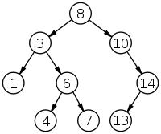
BST Property
Throughout the discussion, our BST will have only unique elements
For a node x, all the data in the leftsub tree of x has to be lesser than x.data and all the data in rightsub tree of x has to be greater than x.data
This tree is a valid BST
If there are duplicates then we need to make consistent decision if our rightchild or leftchild will be the same as the parent.

Slide 5
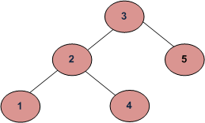
BST Property (cont)
Is this a valid BST ?
No. The left subtree of 3 has node with data 4, violating the BST property.
To check if a BST array is valid, check if for every index of the array, arrayBST[i] > arrayBST[2*i] and arrayBST[i] < arrayBST[2*i+1]

Slide 6
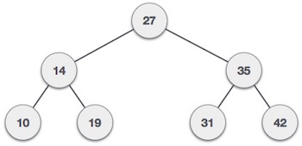
Maximum element in a BST
The maximum element in a BST is always the rightmost element
Why ?
The maximum element is 42. The maximum element is the rightmost element in a BST
How do we get there ?

Slide 7
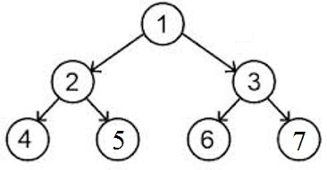
Maximum element in a BST (cont)
Array based solution
getMaxElement(a[], start, end) while (start < end)
start = 2 * start + 1;
return a[start];
Node based solution
getMaxElement(node) while(node.getRightChild != NULL) node = node.getRightChild return node.data
-1 | 1 | 2 | 3 | 4 | 5 | 6 | 7
0 | 1 | 2 | 3 | 4 | 5 | 6 | 7

Slide 8
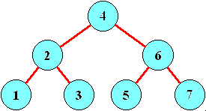
Tree Traversal
Preorder Traversal
4-2-1-3-6-5-7
Inorder Traversal
(always prints in sorted order, useful for checking if a BST is valid)
1-2-3-4-5-6-7
Postorder Traversal
1-3-2-5-7-6-4

Slide 9
Inorder Tree Traversal
Node based
inorderTraversal(node) if node != NULL inorderTraversal(node.getleftChild)
print(node.data)
inorderTraversal(node.getRightChild)
Array based (hint for isValid())
inorderTraversalArray(a, start, end) if (start > end) return inorderTraversalArray(a, 2 * start, end)
print(node.data) //add to list and check if sorted
inorderTraversalArray(a, 2 * start + 1, end)

Slide 10
BST Search
BST makes search efficient and fast
If there are n elements in a BST, the worst case time complexity of a BST-search is maximum height of the tree (in this example – logn)
Why ?
Worst case is when it is unsuccessful and we traverse the whole height of the tree or the key is at the leaf element
searchBST(root, key)
if (root==NULL || root.data==key)
return root;
if (root.data > key)
return searchBST(root.left, key);
return search(root.right, key);
Key – 13
8->10->14->13
Key – 7.5
8->3->6->7->x

Slide 11
Reference
https://www.cs.unc.edu/~plaisted/comp550/15-btrees.ppt
http://www.geeksforgeeks.org/category/data-structures/binary-search-tree/
https://mitpress.mit.edu/books/introduction-algorithms

